Slide 1

Launching High-Fidelity Wireless Headphones
STRATEGIC INITIATIVE
Launching high-fidelity wireless headphones to capture premium market share.
Beats by Dr. Dre — Executive Strategy Presentation
Prepared by Derek | February 09, 2026

Slide 2

Executive Objective
Evaluate the strategic case for launching a premium high-fidelity wireless headphones.
Market Viability
Competitive Positioning
Success Conditions
Size, durability, attractiveness
Differentiation strategy
Requirements for market entry

Slide 3






Strategic Recommendation
To solidify its position as an undisputed leader in the high-end audio market, Beats should launch a premium high-fidelity wireless headphone, driven by innovation and brand elevation.
Key Business Impact
Significant Revenue Opportunity
Projected $500M+ new revenue in the premium segment.
Enhanced Profit Margins
Capture High-Growth Market
Elevate Brand Perception
Achieve 30% higher gross margins than current product lines.
Tap into the rapidly expanding premium audio segment.
Shift from lifestyle to audiophile-grade quality.
Strengthened Market Leadership
Secure top 3 position in the global premium headphone market.
Drive Innovation & Value
Introduce cutting-edge features and superior sound engineering.
This strategic investment is critical for Beats to evolve into a premium sound authority, cementing its leadership and future growth in the competitive audio landscape.

Slide 4
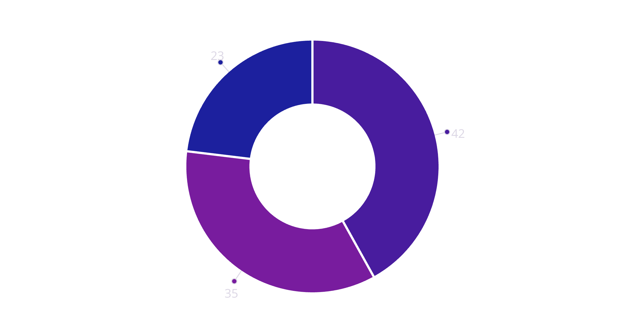
Premium Market Structure
Market Dynamics
Premium segment drives disproportionate profit share despite lower volume. The Premium tier ($300+) represents a minority of units but a disproportionate profit share.
Growing faster than entry-level segments
Hybrid work adoption accelerating demand
Travel recovery driving premium ANC needs
Rising quality expectations
Premium $300+
Mid-tier
Entry-level
A profit-pool opportunity, not speculative trend

Slide 5





What Drives Premium Purchases
Sound Quality
Brand Perception
Reliability
ANC Consistency
Clarity, balance, low distortion. The foundational expectation.
Reputation, trust, and perceived value built over time.
Consistent connectivity and durable performance.
Effective and comfortable noise isolation in all environments.
Premium buyers upgrade to remove friction, not chase features. Small failures = high returns + brand erosion

Slide 6




High-Value Customer Segments
Hybrid Professionals
Premium Commuters
Sound Enthusiasts
Multi-hour daily usage
ANC and reliability focused
Fidelity-driven buyers
Comfort and call quality critical
Strong willingness to pay
Highest economic value
Consistency expectations
Price-insensitive to value
Travel recovery tailwind
Lower volume, high influence
Drive brand perception
Review and recommendation impact
Hybrid professionals and sound enthusiasts are key targets.
Age Correlation
35-54 demographic shows strongest value indicators:
68%
47%
82%
Higher willingness to pay
Lower price sensitivity
Durability priority
Age supports targeting but doesn't define it

Slide 7

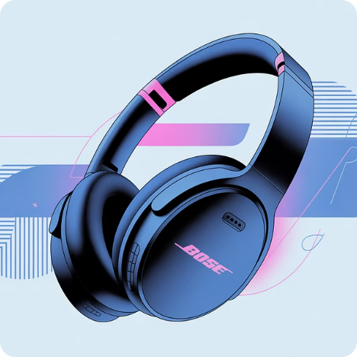
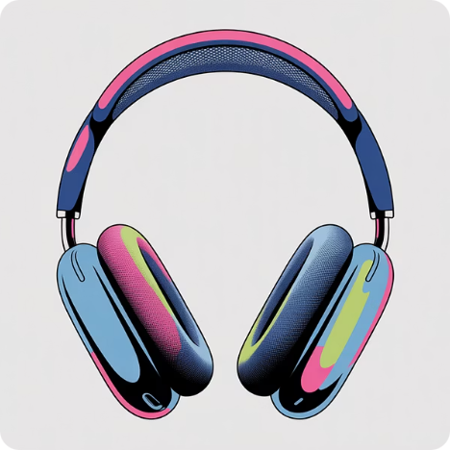


COMPETITIVE ANALYSIS
Premium Market Control
Sony
Bose
Apple
Sennheiser
Technical audio leadership, industry-leading ANC
Comfort engineering, noise cancellation trust
Ecosystem integration, seamless user experience
Heritage sound credibility, audio purist appeal
Premium audio is expectation-driven. Trust and consistency outweigh novelty.
Beats must meet or exceed established premium baselines to compete credibly

Slide 8
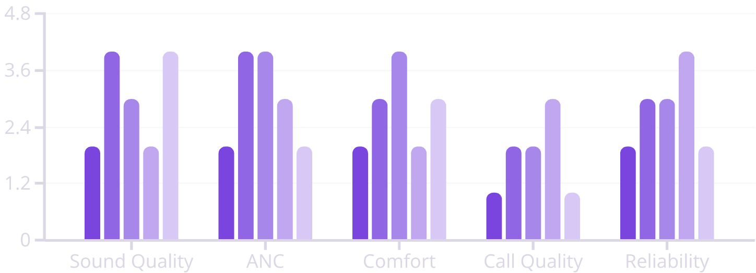
Competitive Landscape & Opportunity
Competitive Performance Matrix
This radar chart compares leading competitors across five critical dimensions: Sound Quality, Active Noise Cancellation (ANC), Comfort, Call Quality, and Reliability, using a standardized scale from 1 (Fair) to 4 (Excellent).
Key insights
Beats demonstrates clear strengths in Comfort and ANC, aligning well with its core lifestyle positioning.
Call Quality represents a differentiating opportunity where Beats can outperform peers with focused improvement.
The visualization provides an at-a-glance view of relative strengths, trade-offs, and white-space opportunities across the competitive set, informing product and positioning decisions.
Sony
Bose
Beats
Sennheiser
Apple
Beats Advantage
Unwavering Reliability
Superior Call Clarity
Seamless Integration
Outperforming competitors by delivering consistent, dependable performance where others falter.
Addressing a significant category-wide gap with best-in-class microphone technology and processing.
Leveraging ecosystem strengths for effortless pairing and user experience across devices.

Slide 9













Competitive Response Strategy
Key Market Insight
From the "Proportion of Positive, Neutral, and Negative Reviews by Brand" chart, a key insight is that Panasonic and Sennheiser face higher negative sentiment compared to other brands.
Expected Competitor Moves
Beats Defense Plan
Spec Upgrades
Incremental feature additions
Sound Credibility
Price Pressure
Disciplined positioning
Promotional tactics
Line Extensions
Portfolio expansion
Messaging
Cross-channel consistency
Market Saturation
Increased competition in core segments
Controlled Launch
Niche Targeting
Perception protection
Targeting specific user groups
Strategy remains viable under competitive pressure through disciplined execution

Slide 10


STRATEGIC PATH FORWARD
Product & Launch Imperatives
A key deduction from the "Distribution of Star Ratings by Brand" chart is that Apple AirPods show tight distribution around 5 stars.
Product Foundation
Market Execution
Premium sound tuning
Built for reliability
Seamless connectivity
Controlled distribution
Premium channel focus
Proactive review management
1
2
3
4
Launch Strategy
Post-Launch Optimization
Credibility-led storytelling
Retail demo validation
Targeted influencer engagement
Gather user feedback
Implement iterative improvements
Monitor market response

